Slide 1
Meet the Teacher 2023-2024
Year 6
Mrs Atkinson
Mrs Mentore – Mrs Saleem and Miss E
Mr Horwood
Miss Khatun-Ali - Miss Eva
Miss Salloub – Mrs Debbih
Mrs Butt
Mrs Julien
PPA Teachers
Mr Thomas
Miss McCauley
Miss Haines
Brent Music Teacher

Slide 2
Personal Details
Ensure the office has up-to-date details for your child.
Address
Emergency contact numbers – two numbers needed
Email address
Medical information

Slide 3
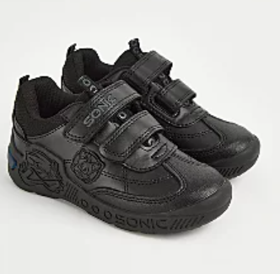
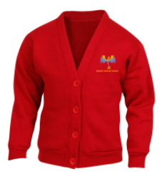
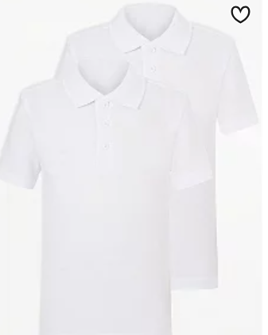
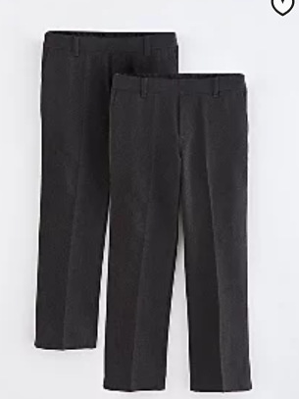
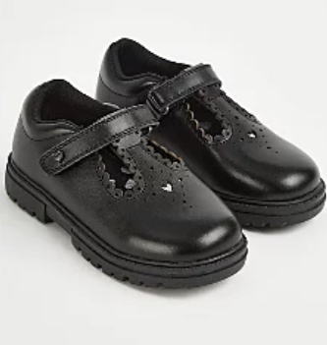
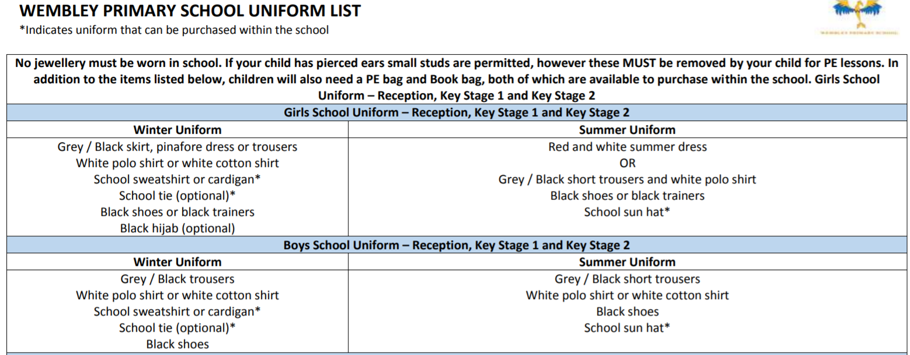
School Uniform
Notes:
Jewellery/hair accessories – red headbands

Slide 4
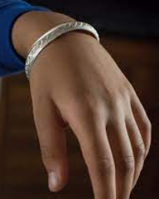
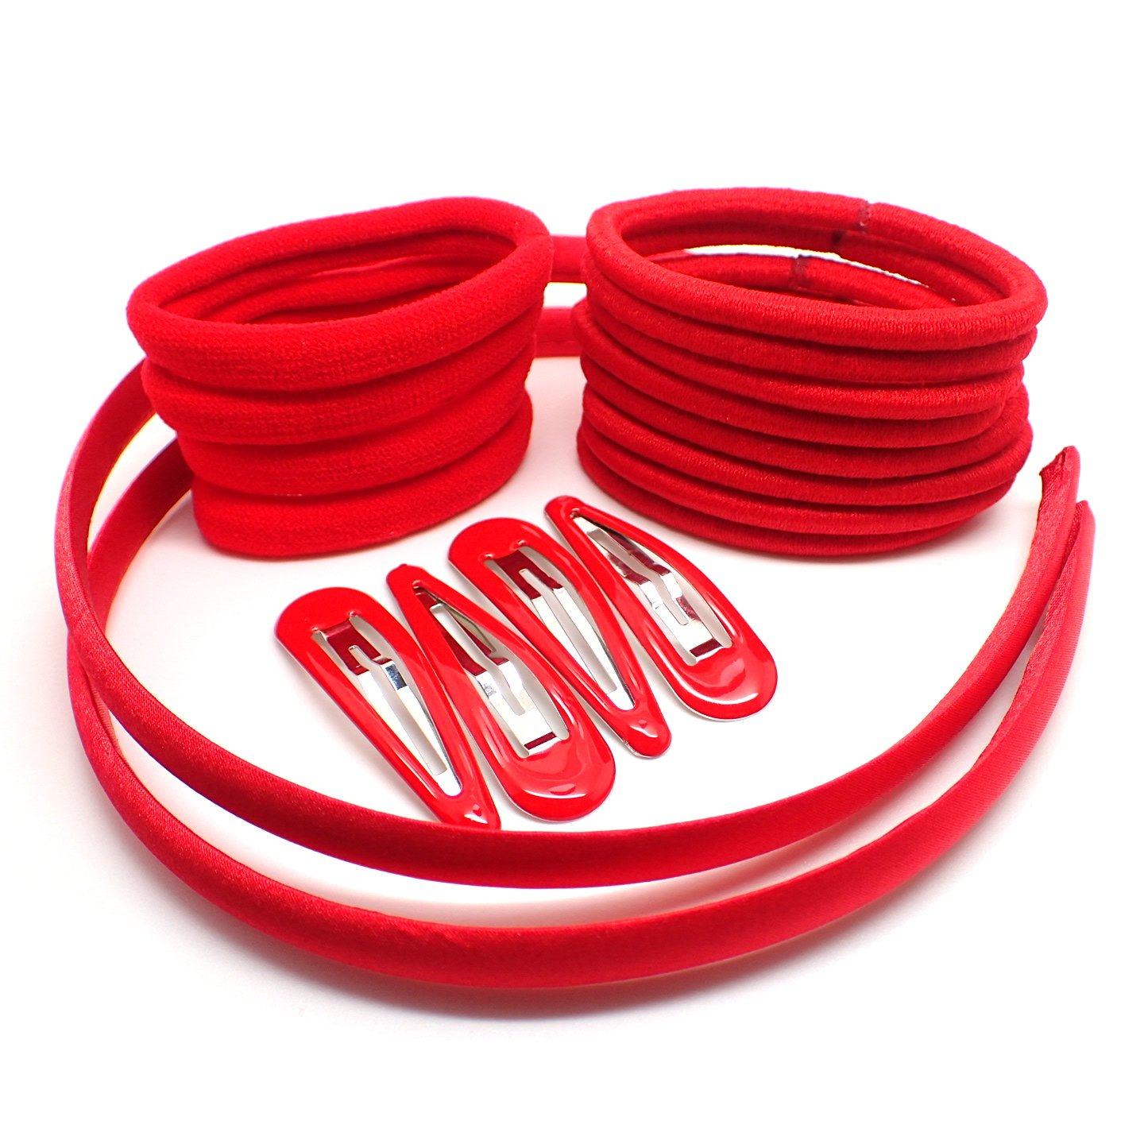
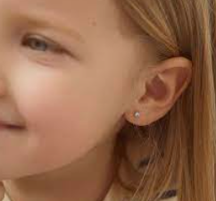
Jewellery
For safety, no jewellery is the best option.
We allow:
Compulsory religious jewellery
Red, simple hair accessories
Small studs

Slide 5
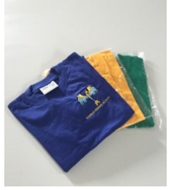
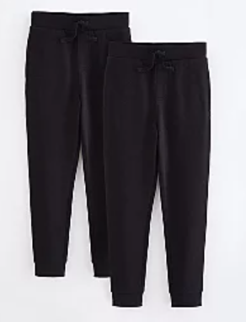
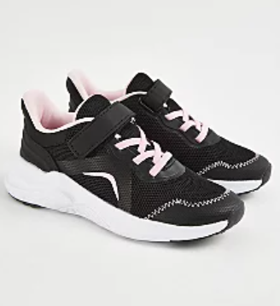
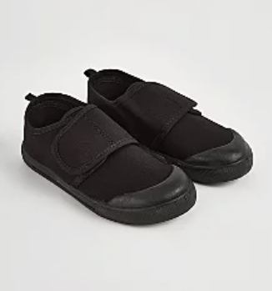
PE Uniform
No hoodies
No football tops
No blades or studs trainers

Slide 6
PE
PE lessons will take place every Friday
6W and 6F – Monday
6P and 6S - Thursday
Please ensure your child comes to school wearing their PE kit.
House Team t-shirt or white t-shirt
Black Jogging bottoms, leggings or shorts
Trainers
School jumper

Slide 7
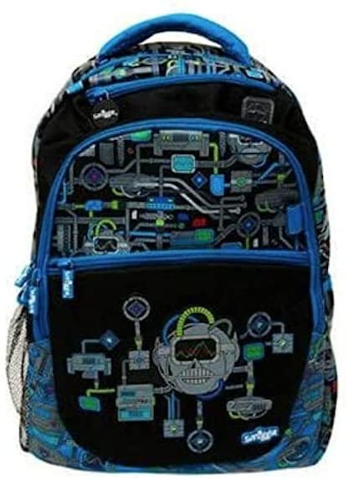
Things your child needs to bring
Do not bring bulky back packs
Bring a waterproof bag that can hold your home learning books (A4 size) and your reading book, which can fit on the back of your chair.
You may bring a labelled water bottle from home.
Reading book and reading record
Pencil cases should contain:
Pencil
Black Pen
Glue Stick
Colouring Pencils
✓

Slide 8
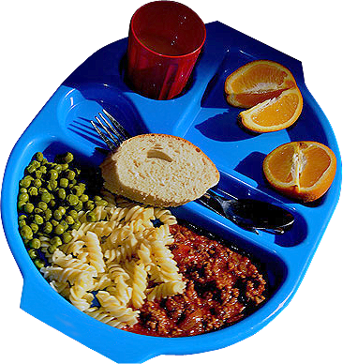
School Dinners
For this year, the government has guaranteed that every child in primary school be offered free school meals.
Previously you have had to complete a form out to be eligible for this, but, for this year, it is not the case.
Should your child still prefer a packed lunch, then please bring this in as they have been doing.
We are unaware about this offer going forward, so you can still apply for this now if the government choose not to offer this benefit in the next few years.

Slide 9
Attendance and Punctuality
It is vital that you come to school every day and on time.
Soft start begins at 8:35.
The register will close at 8.50
If you wish your child to walk home alone, please complete the form from the office and return it ASAP
Please ensure you collect your children on time from the playground at 3:30.
If there are changes to who is picking your child up, you MUST inform the office.

Slide 10
Reading
You will be expected to read for at least 30 minutes every day. This should be a banded book.
Your child needs to fill in their reading record every night with a summary of what they have read and any new vocabulary they have acquired.
Children’s book bands are determined upon performance in class and on assessments.
Teachers will regularly check reading records.
Please bring reading records to school every day.
9/9/2023 Star Light p.5-25 | Vital – extremely important Treacherous – very dangerous The impression I get of the witch is that she is old because ‘her withered hand’

Slide 11
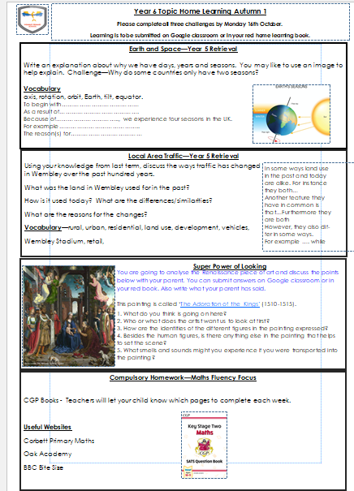
Home Learning
Reading – Banded Books (Black is the highest band)
CGP books for maths and reading comprehension
Home Learning Challenges all three to be completed by the last Monday of the half term.
Spellings – given out every Monday for a test on Thursday.
School website (click on link) https://www.wembleyprimary.co.uk/news/year-6/

Slide 12
CGP Books
Your child’s teacher will set weekly home learning from the CGP book.
Please ensure you provide them with time a space to complete the work.
If they are struggling with the learning please let your child’s teacher know.
CGP learning will be set on Thursdays and should be returned by the following Tuesday.
Please look after these books. If they are lost the school will not replace them.

Slide 13
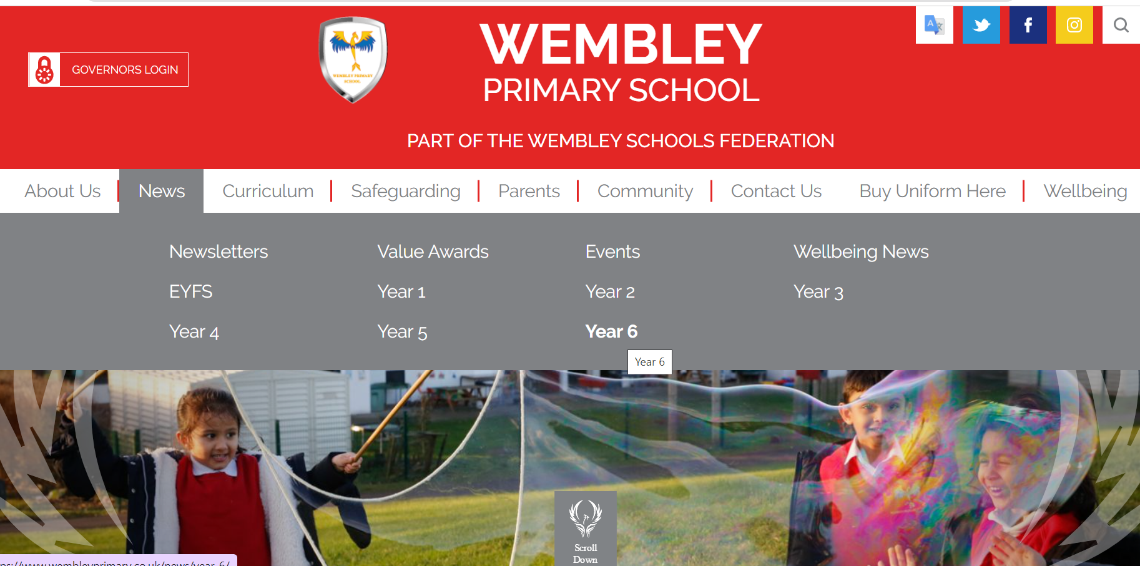
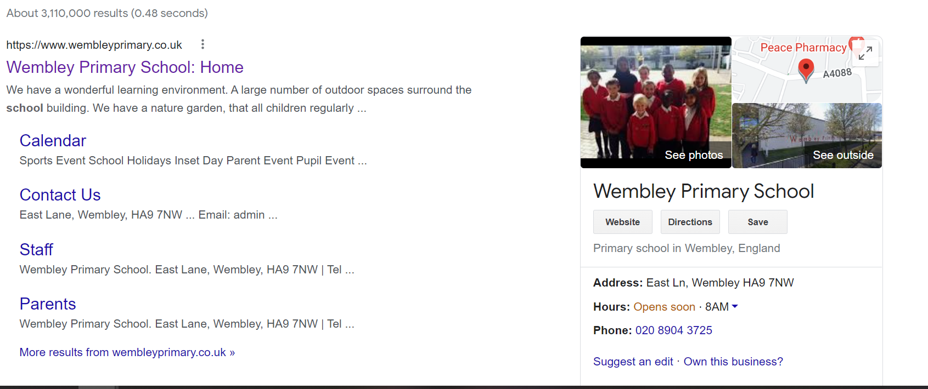
School website any communication with children’s learning will appear on here

Slide 14
Making appointments to see your child’s teacher
If you need to discuss something briefly with us please come and speak to us when you collect your child at the end of the day.
If you are going to need a longer amount of time, then please arrange an appointment via the school office or with the teacher at collection time.
Appointments with a class teacher in a morning need to be before 8:30am. Teachers are supervising pupils as of 8:35am.
Updating you on your children's progress – we will do this through our parents meeting and reports. If you have concerns then please do come and discuss with us.

Slide 15
After School Clubs
If a space is available, children will be given their 1st choice club then removed from any additional preferences
Waiting lists will be created if a club is over-subscribed and additional spaces if more adults are able to support. You will be contacted from the school office, if a place becomes available.
Invited clubs – you will receive a letter from a class teacher prior to clubs becoming available. This is a free club and will run for 8 weeks or more dependent on the teacher.
Notes:
1. Aim to allow more children to attend a club rather than one pupil to attend multiple (fairness)

Slide 16
Trips
A parent calendar of key dates will be released for each term
We are planning trips to :
Tower of London
Geography Orienteering Trip
Some trips may need parent helpers. If you are able to help your child’s teacher will let you know if you have been chosen.

Slide 17
The online world
There are lots of positives:
Teamwork and creativity
Knowledge
Socialisation
But there are negatives too:
Sleep cycles
Attention span
Online risks

Slide 18
The 4 Cs of Online Safety
Content – What children see online
Contact – Who children talk to online
Conduct – How children behave online
Commerce (or contract) – Advertising, marketing, scams etc.

Slide 19
Resources
Internet matters
Full of useful information for parents. Including parental controls and privacy settings.
internetmatters.org

Slide 20
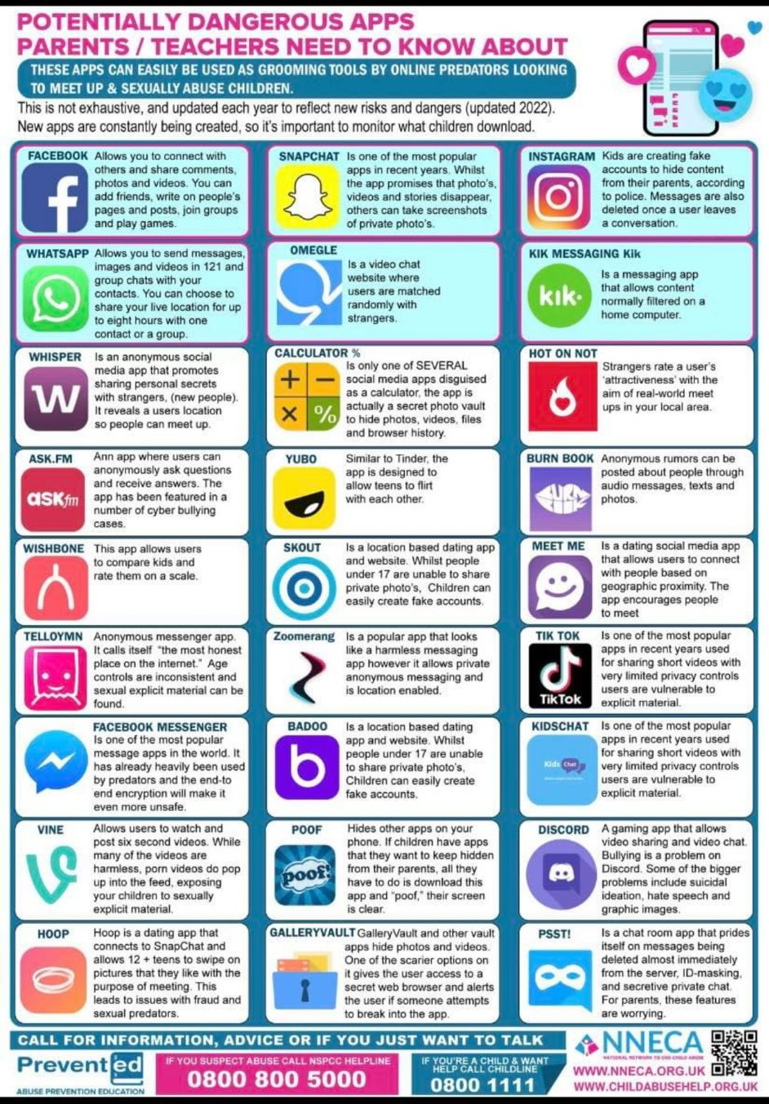
Online Safety
Understand the risks but keep them in proportion.
Communicate regularly – what are they doing, who are they talking to
Ensure the apps they are using are age-appropriate.
Develop strategies with you children
You are the parent, having a device is a privilege not a right.

Slide 21
Secondary School
Meeting this afternoon at 3:00 pm.

