Slide 1
Year 6 Secondary Applications
September 2021 - 2022

Slide 2
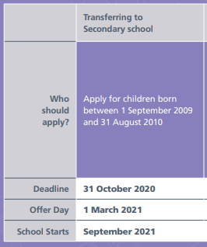
Schools Admissions
Last day to apply by
You have two weeks from this date to ACCEPT your offer

Slide 3
Schools Admissions
Went ‘live’ on September 1st
You have until 31st October 2021
You can apply for up to 6 schools
Decide order of preference
First offer day: 1st March 2022
Please apply online – will need to create/remember login details

Slide 4
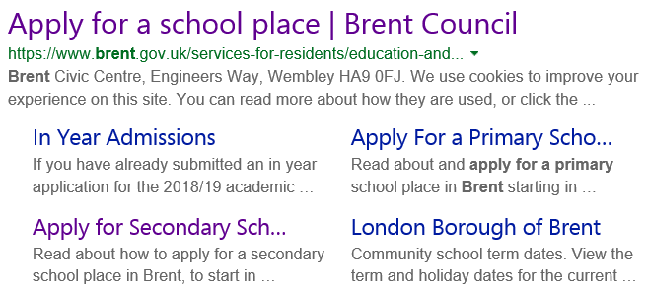
How to Start
Google Brent Admissions
CLICK HERE

Slide 5
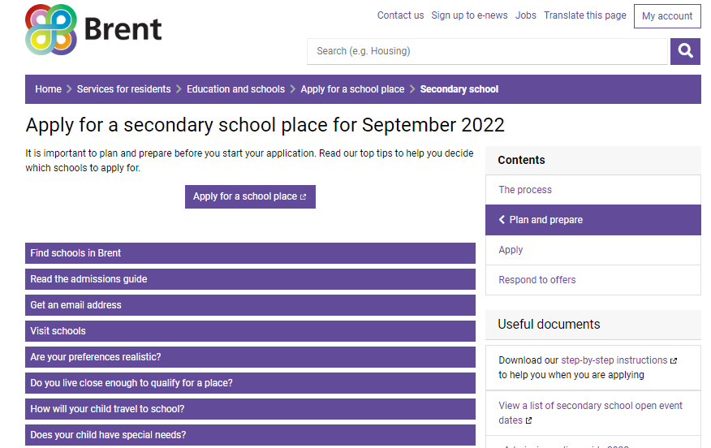
Click here to go to the admissions page

Slide 6
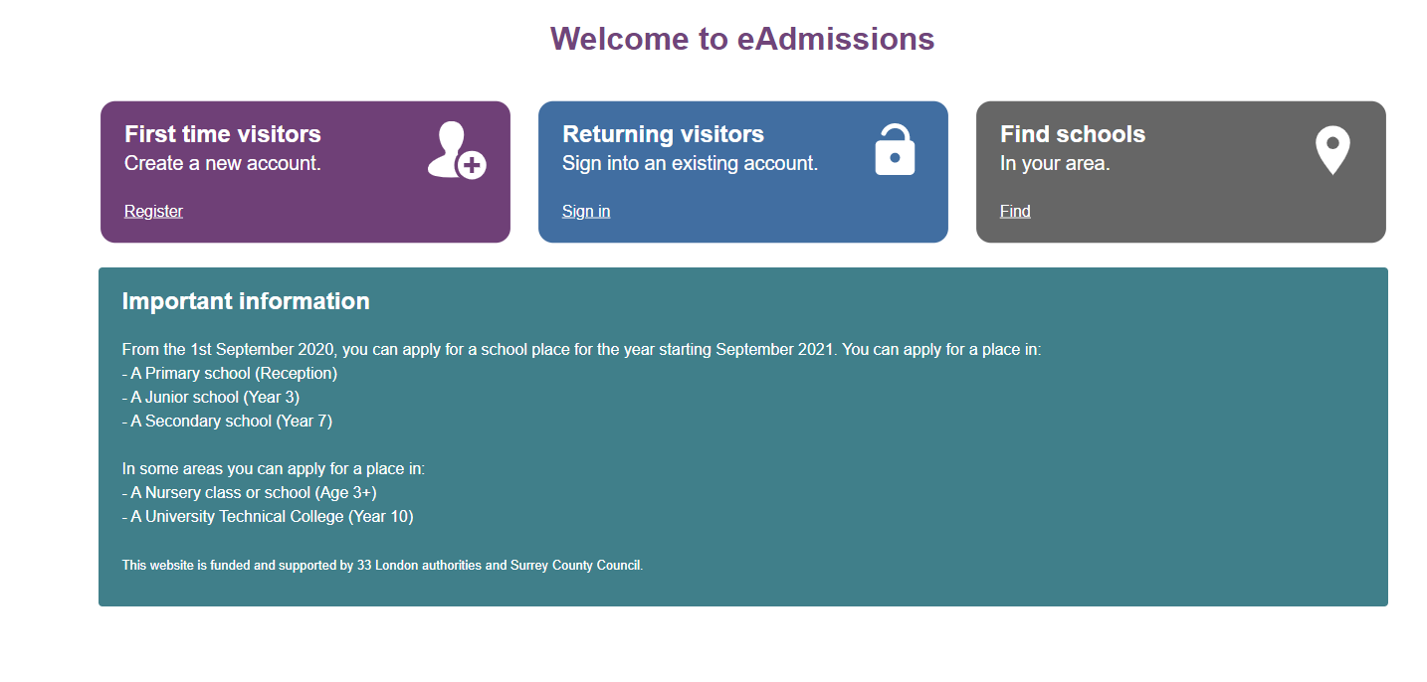
Register for first time use.
Click here for the guide
You will need your details used when you applied for Primary school

Slide 7
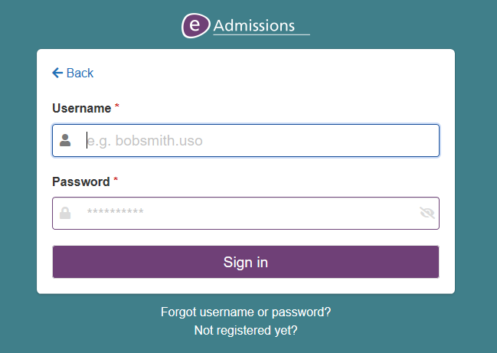
This will end .uso
e.g. katkinson.uso
Here is a video to show you how to change your details.

Slide 8
Guide on How to Apply
For a guide on how to apply and use the eadmissions website and for further information on secondary schools in Brent, please click the links for the following documents:
Step-by-step application guide – eadmissions
Brent How to Apply guide – Brent council
Brent Secondary School Information

Slide 9
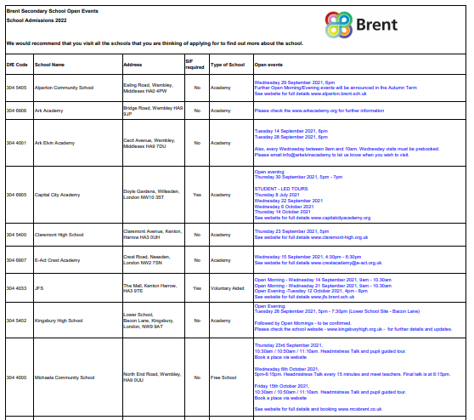
Secondary School Open Evenings
A full list can be found on the Year 6 News page on the school website

Slide 10
Key Information
Do not just put one school down – or the same one 6 times!
You will only be offered one school
It will be the highest ranked school that you are eligible for
Look at the way the schools admits pupils
If there are no other siblings at a school, the next criteria tends to be feeder schools or distance from your house
You will go on the waiting list for any school above your offer that you did not get, for the next academic year only
If applying for a school outside Brent, still use the Brent form.

Slide 11
What will happen next?
Offers will be emailed to you on the evening of Tuesday 1st March 2022. Usually by 5pm.
You must accept or decline your offer by Tuesday 15th March 2022. We advise that you ACCEPT the offer given to you, as you will remain on the waiting list for any other preferred school
If you decline the offer you may receive a further offer in the second or third rounds
Further guidance on accepting offers can be found here

Slide 12
Key Dates
Apply by 31st October 2021
Offer date 1st March 2022
Deadline for acceptance –
15th March 2022

Slide 13
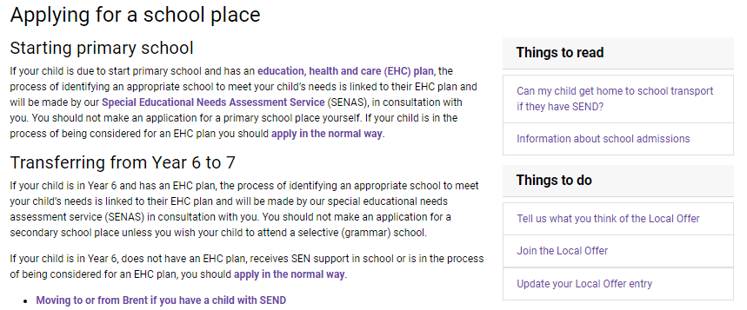
Click here to read the information in full
Please make an appointment with Ms Griffiths (School SENCO) to complete this process.

